Slide 1
AI AGENTS & RAG · LESSON 2 OF 3
Building RAG with n8n
Lesson 2 — Retrieval and the RAG Chat Agent
Today: from a stored vector to a grounded answer
Beginner · 120 minutes · No coding required
Notes:
Welcome back. Lesson 1 was about permission — proving n8n could see a file. Today is about the part people actually mean when they say RAG: a question comes in, the store is searched by meaning, and an answer is written from what came back. Two warnings to set up front: we start by finishing Workflow 1, because you cannot retrieve from an empty store; and the most important thing you will learn today is how to make the agent admit it does not know.

Slide 2
ROADMAP
What we do today
1
2
3
4
Fill the store
Understand retrieval
Build the agent
Test it honestly
Finish Workflow 1 and run it, so the document is actually indexed.
What happens between pressing Enter and reading an answer.
Chat trigger, Gemini, memory, and the retrieval tool.
One question it can answer, and one it must refuse.
WHERE WE STOP
By the end of today the system answers questions from your document. What it still cannot do is index a new file on request — the agent asks, but the tool is not wired up. That is Lesson 3, and it is deliberately left broken so you can see why it breaks.
Lesson 2 — Retrieval and the RAG Chat Agent
2
Notes:
Set the pace: 25 minutes finishing Workflow 1, 25 on theory, 55 building, 15 testing. Tell them now that one tool on the canvas is deliberately dormant, or half the class will spend the lab convinced they broke something.

Slide 3
PART 1
Fill the store first
You cannot retrieve from an empty vector store. Before anything else, we finish the workflow Lesson 1 started.
Notes:
Transition. Ask: what did Lesson 1 actually achieve? Answer: permission and a file ID. Nothing was stored. That is what we fix in the next twenty-five minutes.

Slide 4
THE MAP
Every RAG system has two phases
PHASE A — INDEXING · once per document
Find
Load
Extract
Split
Embed
Store
Lesson 1 did the first one. Today we do the other five.
PHASE B — ANSWERING · every single question
Embed the question
Search
Top 4 chunks
Build prompt
Generate
This is what we build after the break.
TWO WORKFLOWS, ONE MEETING POINT
Workflow 1 does Phase A. Workflow 2 does Phase B. They never talk to each other directly — they meet at the vector store, through a shared name called a memory key. Today that name is user_documents, and it must be spelled identically in both.
Lesson 2 — Retrieval and the RAG Chat Agent
4
Notes:
This is the diagram to draw on the whiteboard and leave up all lesson. When a student is lost later, point at it and ask which box they are standing in. The meeting-point idea matters: students expect the workflows to be connected, and they are not — they share a name, nothing more.

Slide 5
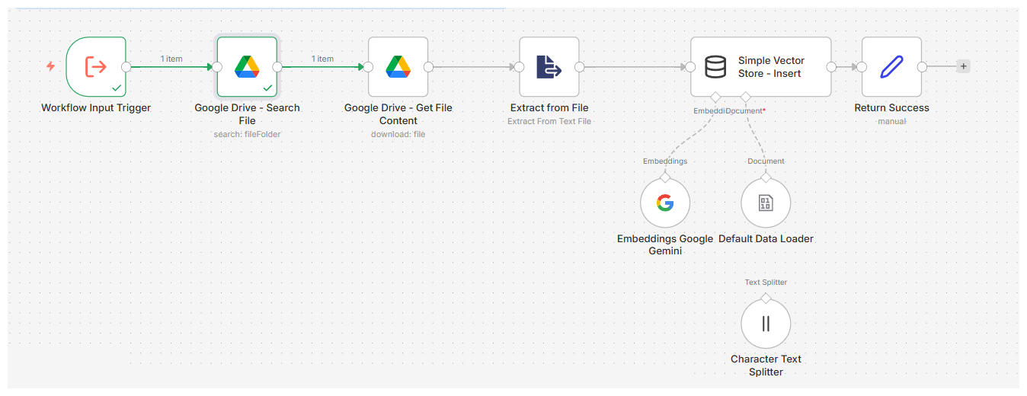
PART 1 · THE LAB
Finish Workflow 1
1
Get File Content download by ID, never by name
2
Extract from File binary becomes readable text
3
Character Text Splitter 1,000 chars, 200 overlap
4
Embeddings Gemini gemini-embedding-001
All the nodes were already on the canvas.
5
Simple Vector Store key: user_documents
THEN RUN IT — AND CHECK THE OUTPUT
Set query to University_AI_Course.txt, click Execute workflow, and open the Embeddings node afterwards. Its output panel is a wall of numbers. That is an embedding, and it is the first time students see one.
Lesson 2 — Retrieval and the RAG Chat Agent
5
Notes:
Step 4 is the one to slow down on. Have every student read their embedding model name aloud, because they will need the identical value in Workflow 2 and a mismatch there fails silently. Ending on the wall of numbers is worth the thirty seconds — it makes the abstraction concrete.

Slide 6
READ THIS TWICE
The store lives in memory and forgets
Lost on restart
Global, not per-workflow
Development only
Restart n8n and the store is empty. Workflow 1 must be run again before anything can be retrieved.
The memory key is shared across the whole n8n instance. That is why Workflow 2 can read what Workflow 1 wrote.
n8n says so itself. Fine for learning, wrong for production — there you would use a real vector database.
THE FIRST QUESTION TO ASK WHEN NOTHING IS FOUND
Has n8n restarted since Workflow 1 last ran?
Lesson 2 — Retrieval and the RAG Chat Agent
6
Notes:
This slide prevents the single most common support question of the whole lesson. Say it plainly: if the agent claims it cannot find anything, do not debug the agent — re-run Workflow 1 first. It takes fifteen seconds and resolves it most of the time.

Slide 7
PART 2
How retrieval works
What happens in the two seconds between pressing Enter and reading an answer.
Notes:
Switch to concepts. They now have a populated store, so everything here is about something real rather than hypothetical.

Slide 8
THE STEP STUDENTS MISS
The question is embedded too
“What score do I need to pass?”
Typed question
Embedding model
3,072 numbers
Compare to every chunk
Closest 4
Nothing is searched by words
Which is why this works
Not one keyword is compared. Both sides are numbers before anything is matched.
Neither “score” nor “pass” appears in the sentence about 70%. Meaning matches; characters do not.
CONSEQUENCE
The question and the documents must go through the same embedding model. A position on one model's map means nothing on another's.
Lesson 2 — Retrieval and the RAG Chat Agent
8
Notes:
Ask the class to find a shared keyword between the question and the source sentence. There isn't one. That gap is the whole argument for embeddings, and it is the same example from Lesson 1 — now they can watch it actually happen.

Slide 9
ONE SETTING, ONE TRADE-OFF
Top K — how many chunks come back
Top K = 1 only the closest chunk · an answer spread across two chunks is lost
Top K = 4 (ours) enough context, little noise · sensible for a short document
Top K = 25 the useful sentence is buried · vaguer answers, higher cost
NOT A QUALITY DIAL
Turning Top K up does not make answers better. It trades recall against noise, and the right value depends on how long your chunks are and how scattered the answer is. Students will test both extremes in the homework.
Lesson 2 — Retrieval and the RAG Chat Agent
9
Notes:
If you have a spare five minutes in the lab, set Top K to 1 live and ask a question whose answer spans two chunks. The degradation is obvious and memorable, and it costs nothing to demonstrate.

Slide 10
THE CLASSIC CONFUSION
Memory is not the knowledge base
Window Buffer Memory
Simple Vector Store
Holds the last 8 conversation turns.
Scope: one chat session.
Lost when the session ends.
Answers: “What did I just ask you?”
Holds your indexed document chunks.
Scope: the whole n8n instance.
Lost when n8n restarts.
Answers: “What score do I need to pass?”
A TEST YOU CAN RUN IN THE LAB
Ask a document question, then ask “what did I just ask you?”. Open the execution log: the second question never called the retrieval tool. Two kinds of remembering, visibly doing different jobs.
Lesson 2 — Retrieval and the RAG Chat Agent
10
Notes:
Students routinely assume that once a document is indexed it is 'in the chat's memory'. Separating these two ideas early prevents a lot of confused questions in Lesson 3, where both are in play at once.

Slide 11
WHY A TOOL AND NOT A STEP
The agent decides; it does not always search
“Hello” ordinary conversation → no tool called
“What score do I need to pass?” about the documents → calls user_documents
“What did I just ask?” answered from memory → no tool called
“Add my thesis to the knowledge base” an indexing request → calls add_google_drive_file
THREE COMPONENTS, THREE JOBS
The agent decides which tool to call. The chat model writes the sentences. The vector store finds the facts. Students routinely credit the chat model for all three — ask them which one found the 70%.
Lesson 2 — Retrieval and the RAG Chat Agent
11
Notes:
If retrieval were a fixed step it would run on 'Hello' too, and the model would receive four random chunks of a syllabus before saying hello back. That is the concrete argument for making it a tool.

Slide 12
PART 3
Build the chat agent
Import Workflow 2, wire up the model, the memory and the retrieval tool — then read the system message properly.
Notes:
Back to clicking. Eight short steps. Circulate during steps 5 and 6, which are where mismatches creep in.

Slide 13
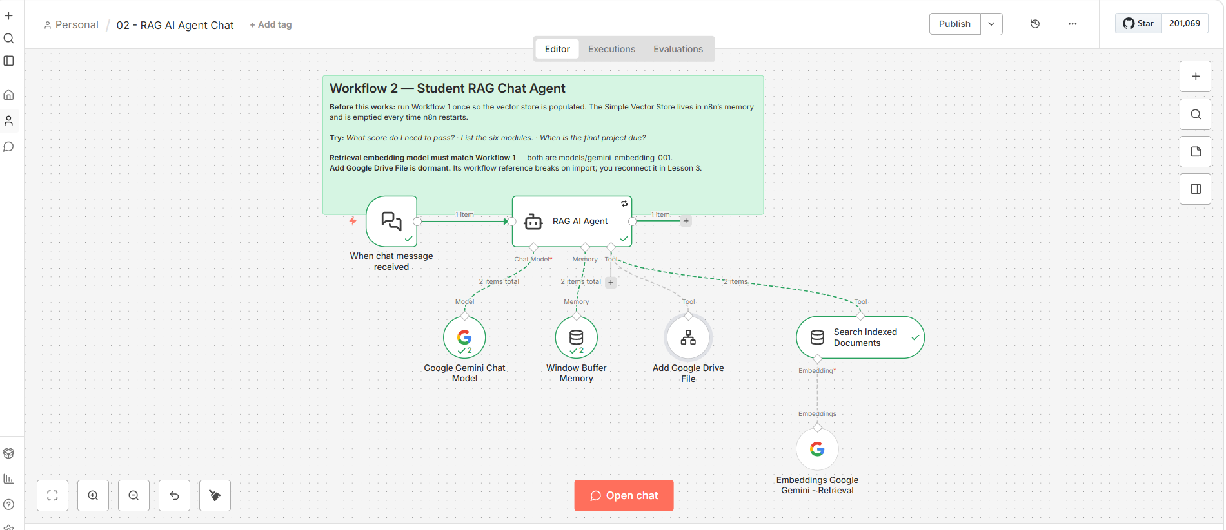

Slide 14
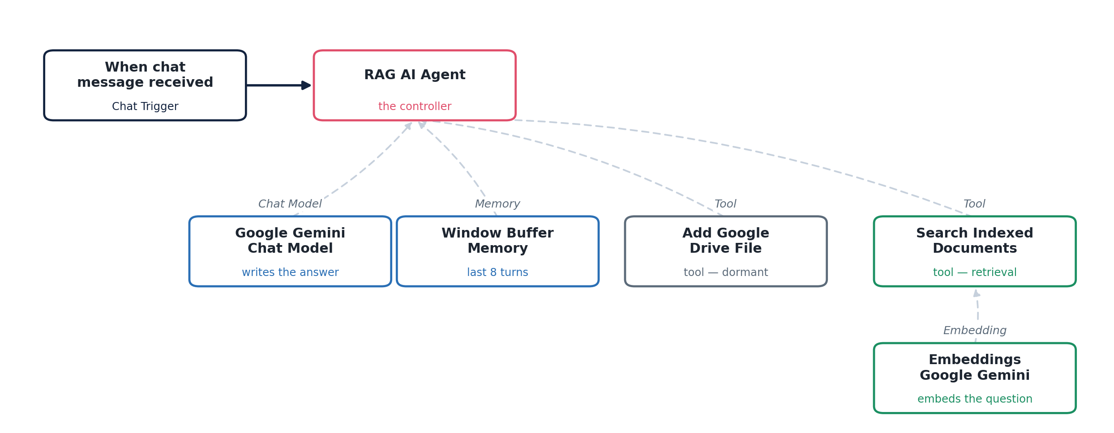
WORKFLOW 2
One agent, and things it can reach for
Working today · retrieval, memory, chat model
Dormant until Lesson 3 · Add Google Drive File
Lesson 2 — Retrieval and the RAG Chat Agent
13
Notes:
Point out the shape: only one node is in the main line. Everything else hangs underneath as a capability. That layout is what an agent workflow looks like, and it is quite different from the straight left-to-right chain of Workflow 1.

Slide 15
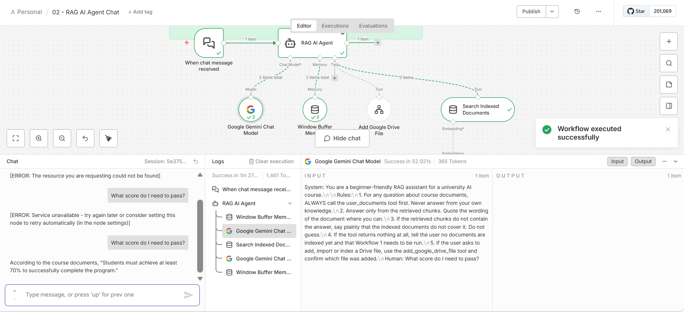

Slide 16
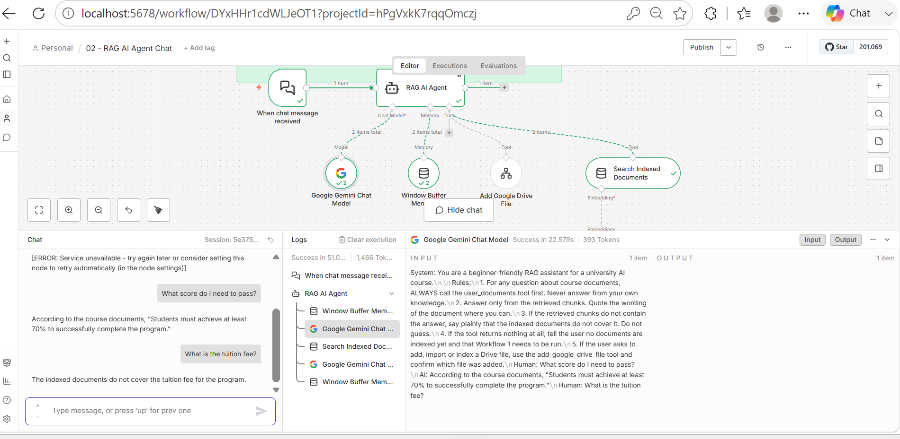

Slide 17
THE POSITIVE TEST
Ask it something the document answers
What score do I need to pass?
✓ A grounded answer
But prove it
“Students must achieve at least 70% to successfully complete the program.”
The number came from the document, not from the model.
Open the Logs panel and find the user_documents tool call. Expand it: you can see the query sent and the chunks returned.
THE SKILL THAT SEPARATES PEOPLE WHO CAN DEBUG RAG
Anyone can read the final answer. Reading what was retrieved tells you why the answer was what it was — and when it is wrong, whether the fault is retrieval or generation. Those two have completely different fixes.
Lesson 2 — Retrieval and the RAG Chat Agent
17
Notes:
Insist that every student opens the log at least once. It converts RAG from magic into a pipeline they can inspect, and it is the single most useful debugging habit they will take from this course.

Slide 18
THE NEGATIVE TEST
Now ask it something the document does not cover
How much does the program cost?
✓ Correct
✕ Hallucination
“The indexed documents do not mention the cost of the program.”
Retrieval found nothing relevant and the agent said so.
Any specific figure at all.
The model invented it. Check rule 3 is present in the system message.
This one question tells you more about a RAG system than a dozen it can answer.
Lesson 2 — Retrieval and the RAG Chat Agent
18
Notes:
Every RAG demo ever given answers the easy questions. Tell students to run this test on every retrieval system they ever build, and to run it before showing the system to anyone. A tool that invents a course fee is worse than no tool at all.

Slide 19
CHECKPOINT
Before you leave the session
Workflow 1 runs end to end and inserts documents
I got the 70% answer in the chat window
I have seen what an embedding looks like
I found the tool call in the execution log
Both embedding models match — I checked
I made the agent admit it did not know
Both memory keys read user_documents
I can explain why the ingestion tool is dormant
THEN EXPLAIN IT TO YOUR NEIGHBOUR
In under a minute, say what happened between pressing Enter and reading the answer. Question embedded, store searched, four chunks returned, chunks plus question sent to Gemini, answer written. If you can name those five, you understand Phase B.
Lesson 2 — Retrieval and the RAG Chat Agent
20
Notes:
Give two minutes for the pair explanation. It is the fastest way to find out who followed the clicks without following the idea.

